Slide 1
Cluster Validation

Slide 2
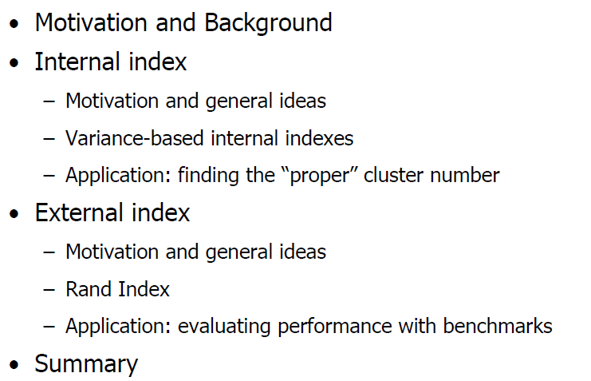
Outline

Slide 3
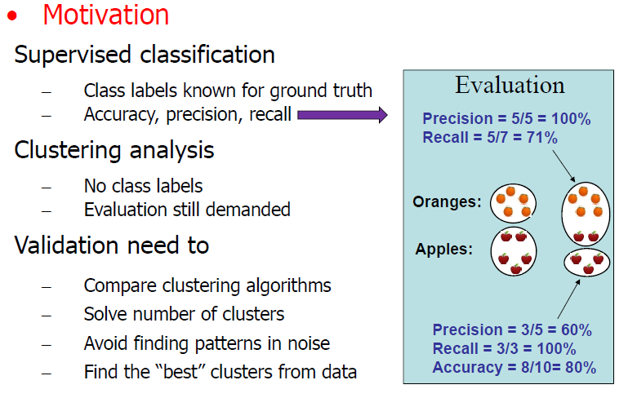
Outline

Slide 4
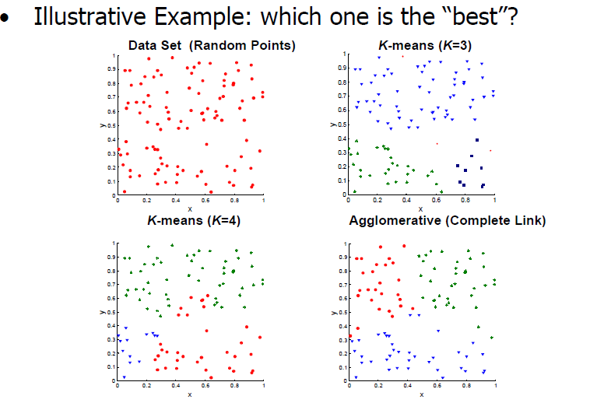
Motivation and Background

Slide 5
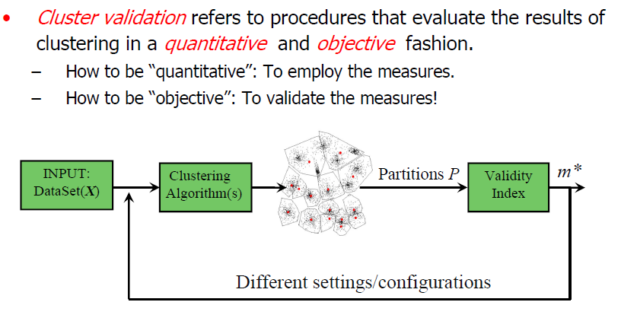
Motivation and Background

Slide 6
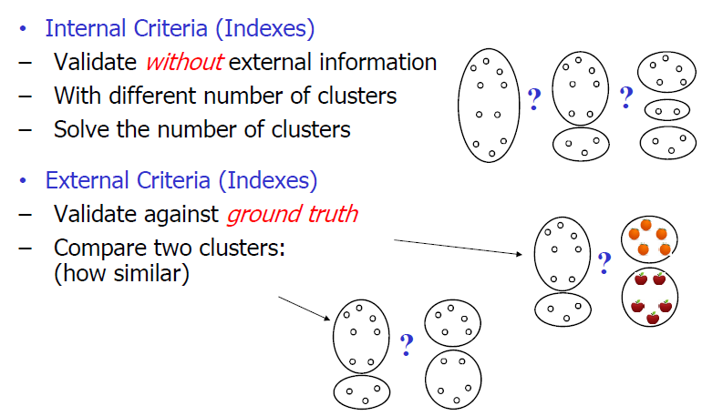
Motivation and Background

Slide 7
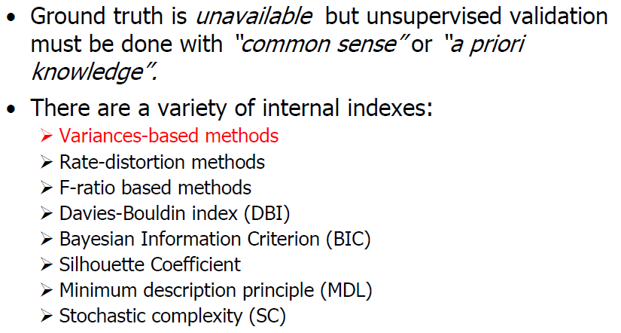
Internal Index

Slide 8
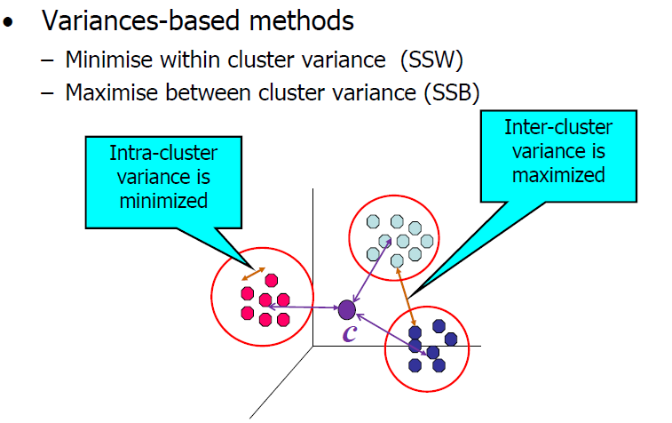
Internal Index

Slide 9
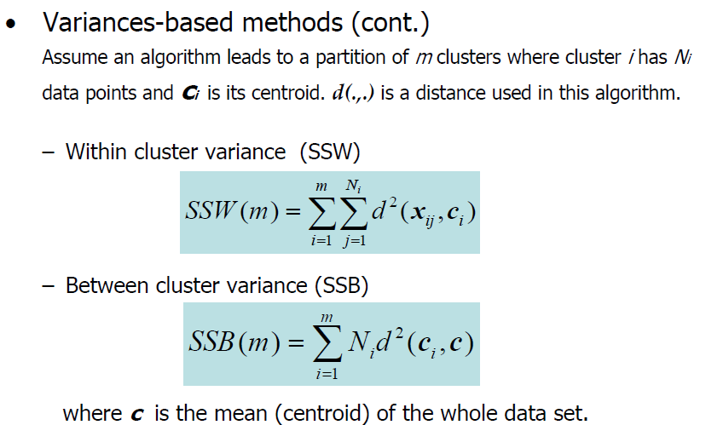
Internal Index

Slide 10
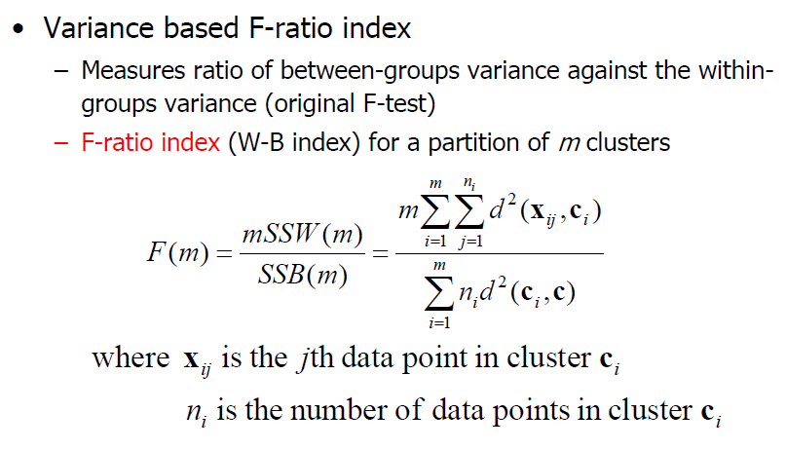
Internal Index

Slide 11
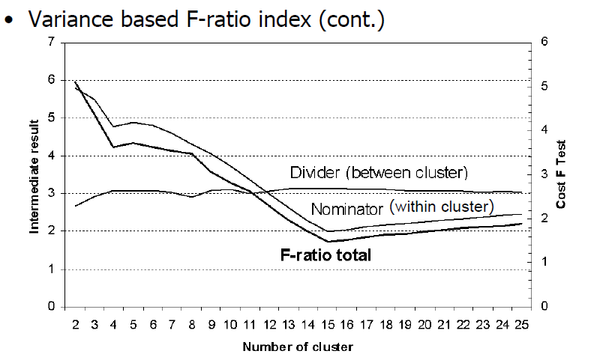
Internal Index

Slide 12
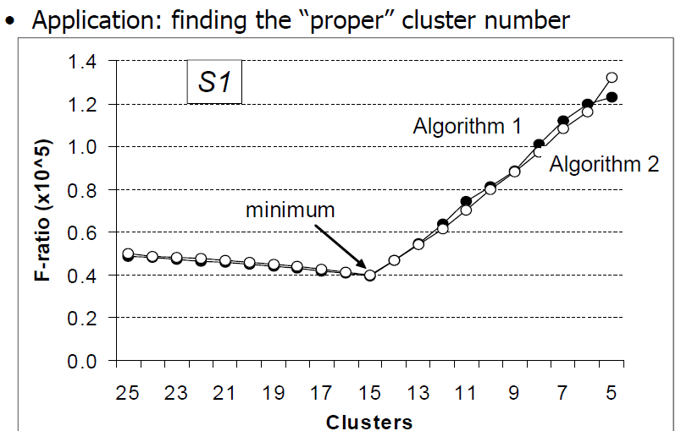
Internal Index

Slide 13
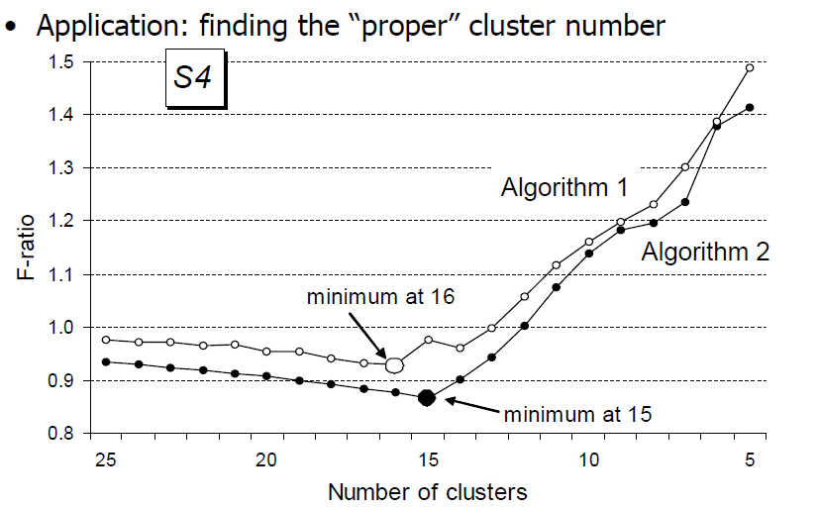
Internal Index

Slide 14
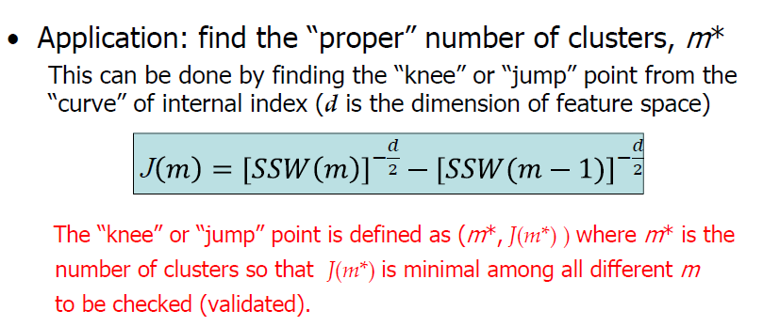
Internal Index

Slide 15
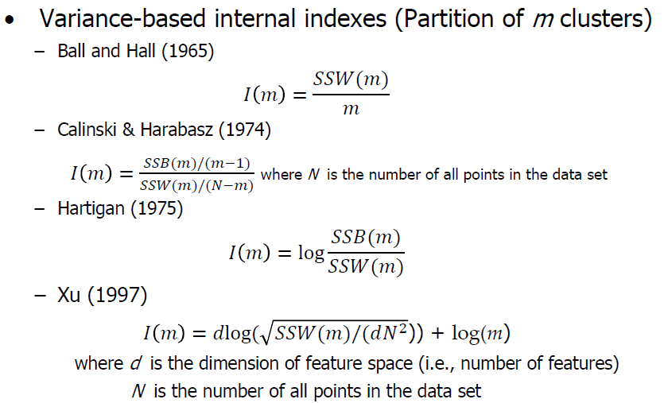
Internal Index

Slide 16
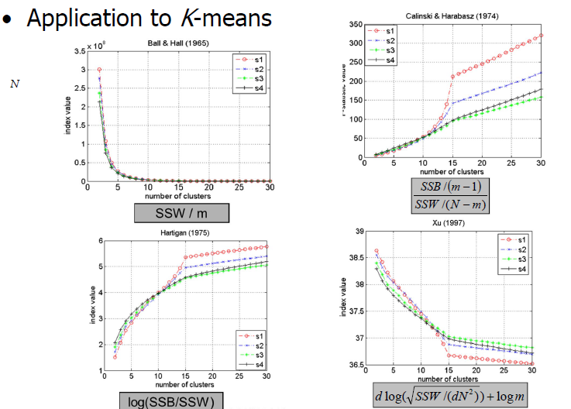
Internal Index

Slide 17
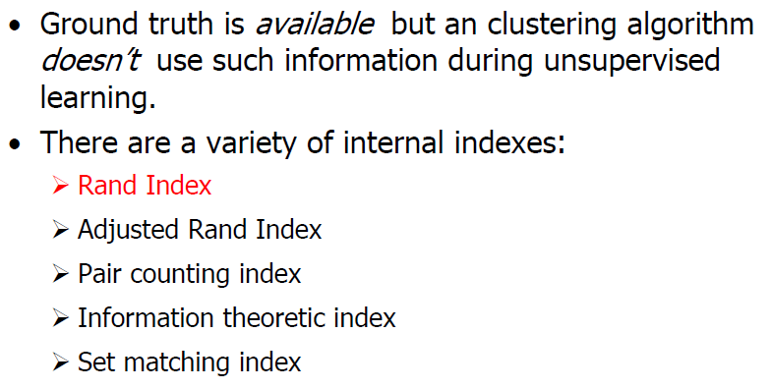
External Index

Slide 18
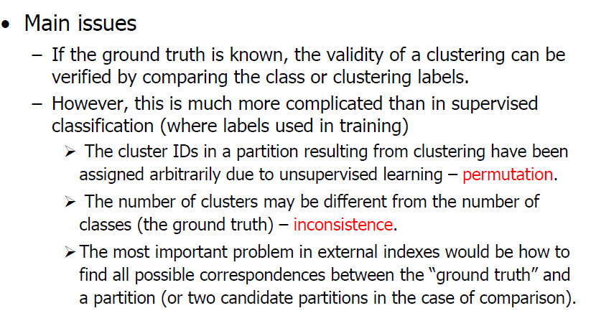
External Index

Slide 19
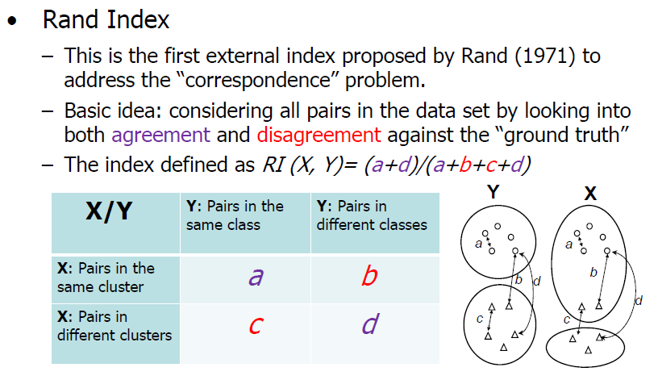
External Index

Slide 20
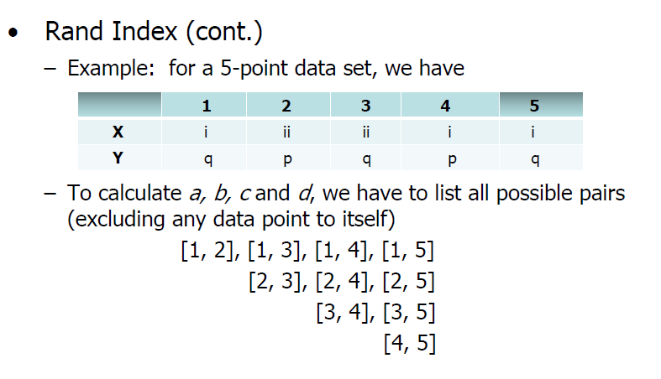
External Index

Slide 21
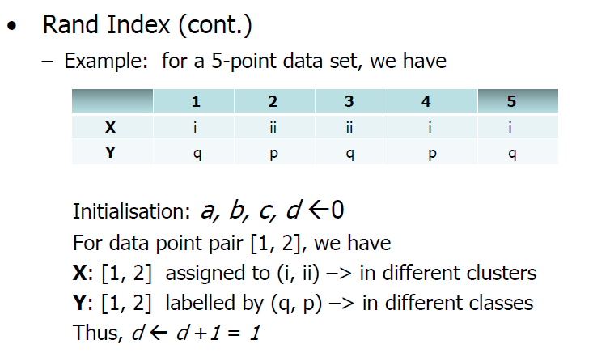
External Index

Slide 22
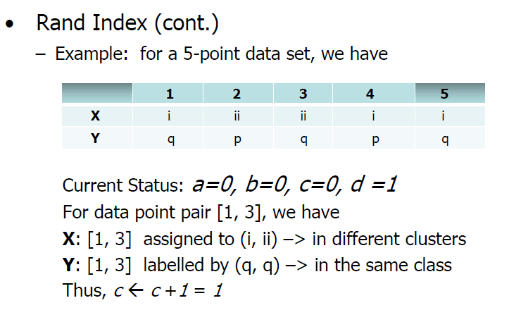
External Index

Slide 23
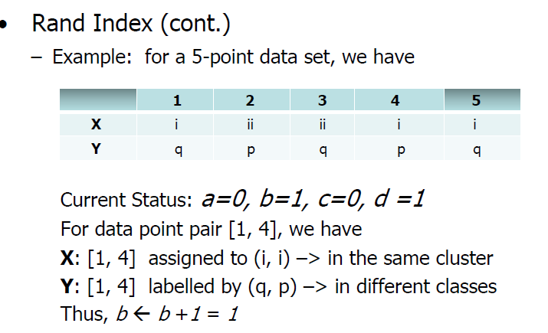
External Index

Slide 24
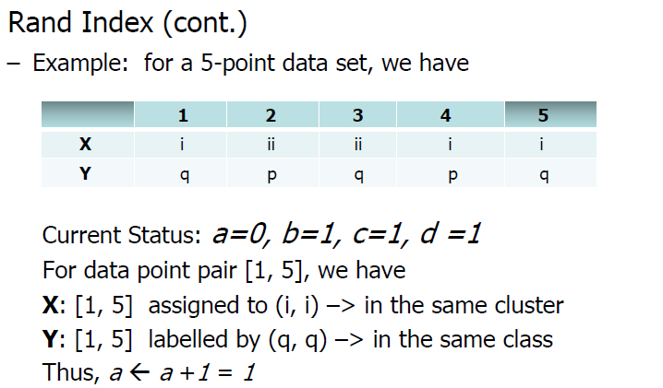
External Index

Slide 25
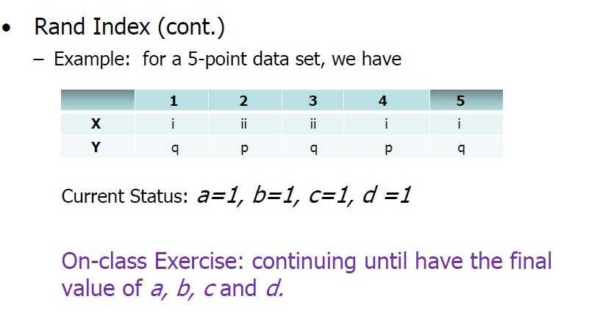
External Index

Slide 26
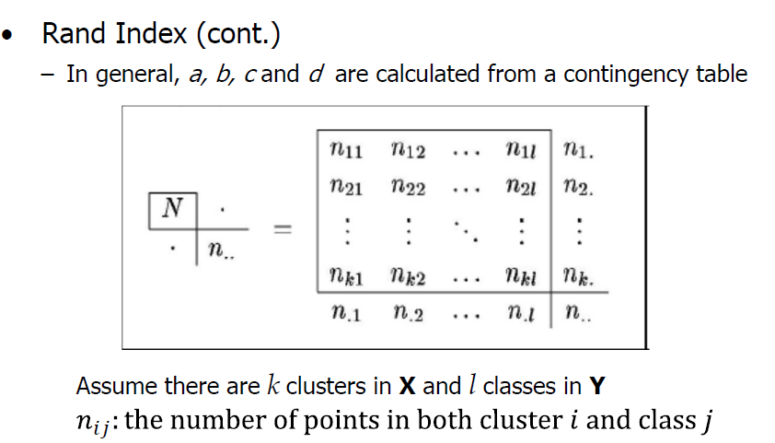
External Index

Slide 27
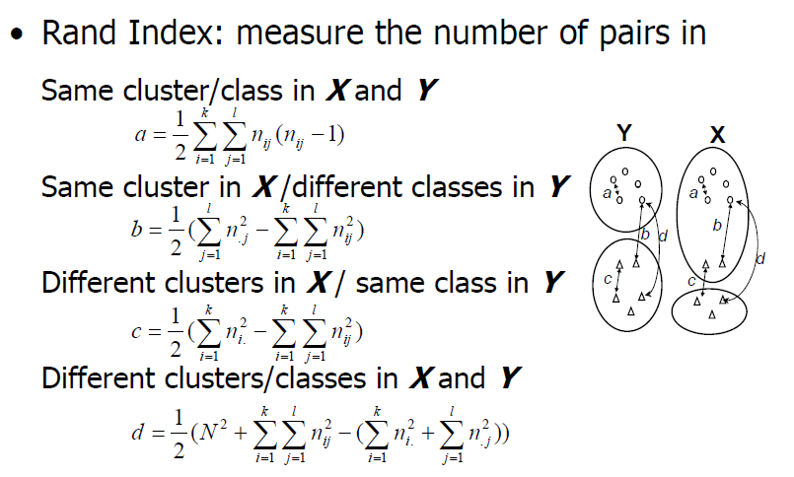
External Index

Slide 28
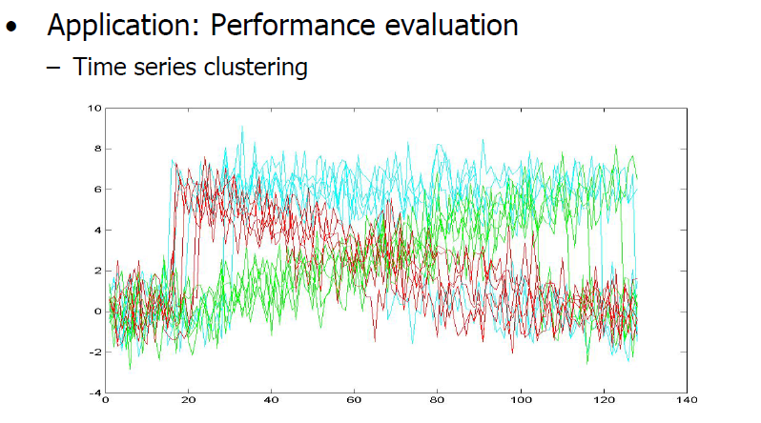
External Index

Slide 29
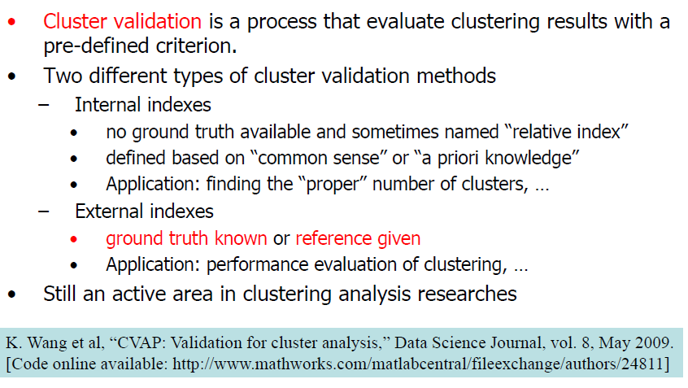
Summary

Slide 30


external
To explain the external validation measures we need a matrix called association matrix. Suppose that a dataset with N objects is partitioned into
C = {c₁,c₂,...c_{I}} classes and the algorithm finds K= {k₁,k₂,...,k_{j}} cluster , then matrix is association matrix where indicates number of c_{i}’s members which belong to k_{i}.
Moreover, a_{i} and a_{j} as marginal numbers is defined by:

Slide 31

external
Mirkin (Mirkin B. , 1996) metric is defined by equation (11) and related to the number of disagreed pairs in the set K and C. Mirkin metric is scaled in the interval [0,1] which is 0 for identical sets of levels or complete finding of the pattern and positive otherwise.

Slide 32


external
Purity The purity of a cluster is defined as follows:
The above purity determines the class that was predicted by k_{p.} The larger the value of above equation shows more common objects in cluster k_{p} and the predicted class. The purity of whole solutioncan be defined by using a weighted mean of the individual cluster purities.

Slide 33


external
F-measure It is widely used in information retrieval and is based on two concepts of precision and recall which indicate accuracy and coverage of retrieved information correspondingly, and are defined by:

Slide 34

external
F-measure of cluster k_{i} regards to class c_{j} is the harmonic mean of its precision and recall. it has a low value for a situation in which recall and precision are unbalanced. This value is defined by:
Consequently , F-measure of a cluster is defined by:

Slide 35

Adjusted Rand Index (ARI) It is one of the most popular external validation measures ranging from 0 to 1.Higher value of ARI shows better quality of clusters. To explain ARI four quantities based on pairs of objects are defined: ’a’ is the number of pairs which are in the same class in C and in the same cluster in K,’b’ is the number of pairs which are in the same class C but not in the same cluster in K,’c’ is the number of pairs which are different classes of C but in the same cluster in K,’d’ is the number of pairs placed on different classes and cluster C and K. According to these quantities rand index(RI) is defined by:

